Slide 1

Intrusion Prevention System (IPS)
H17M 34

Slide 2
OUTCOME 1
Describe Intrusion Prevention Systems
Describe types of Intrusion Prevention
Differentiate between various detection methods

Slide 3
OUTCOME 2
Install an Intrusion Prevention System
Configure the IPS for Common Attacks
Test the Intrusion Prevention System

Slide 4


Assessment 1
Assessment Task 1 : Report (Outcome 1)
This is an open-book assessment where the candidate will produce an 1000 words
(approximately) report as evidence for this Outcome. The report requires investigation, analysis and synthesis of information.

Slide 5
Assessment 2
Assessment Task 2: Practical (Outcome 2)
Observation checklist and annotated configuration printouts or files

Slide 6

Intrusion Prevention systems
Intrusion Prevention Systems (IPS) are network security tools that monitor network traffic to detect and prevent vulnerability exploits.
The purpose of an IPS is to identify malicious activity, log information, block harmful traffic, and report threats in real-time.

Slide 7
The Importance of IPS in cybersecurity
IPS provide an essential layer of proactive defense against cyber threats.
It also provides real-time monitoring and automatic response to potential threats
IPS often integrate with firewalls and other security measures for enhanced protection.

Slide 8
Intrusion Detection Vs Intrusion Prevention
An Intrusion Detection System (IDS) is a security control or countermeasure that has the capability to detect unauthorised access to resources on a network, highlighting irregularities on pre-configured criteria.
Some of the most frequently spotted attacks by a network IDS:
Application layer attacks, such as directory traversal attacks, buffer overflows, or numerous forms of command injection.
Network sweeps and scans.
Flooding denial of service (DoS) attacks in the form of TCP SYN packets.

Slide 9

IDS
Intrusion Detection System (IDS) is a rapidly growing field that deals with detecting and responding to malicious network traffic and computer misuse. Intrusion detection is the process of identifying and (possibly) responding to malicious activities targeted at computing and network resources.
Any hardware or software computerisation that monitors, detects or responds to events occurring in a network or on a host computer is considered relevant to the intrusion detection approach.
Different IDSs provide varying functionalities and benefits.

Slide 10

IDS
An attempt to break or misuse a system is called “intrusion”. An intrusion normally exploits a specific weakness and must be detected as speedily as possible. An intrusion detection system is a system for detecting such intrusions.
Intrusion detection systems are notable components in network security infrastructure. They examine system or network activity to find possible intrusions or attacks and trigger security alerts for the malicious activities.
They are generally categorised as signature-based and anomaly-based detection system.
Other categories are network-based and host-based intrusion detection systems.

Slide 11
IDS
There is a critical need to be able to deliver systems that can automatically detect intrusion patterns and performance bottlenecks, and dynamically defend themselves.
The main goal of an intrusion detection system is to survive the system and retain its essential services.
Survivability is often defined by resistance, recognition and recovery.
Resistance deals with hardening a system to prevent a break-in or other malicious acts.
Recognition is to detect intrusive behaviour from normal behaviour.
Recovery deals with ways of surviving malicious acts.

Slide 12
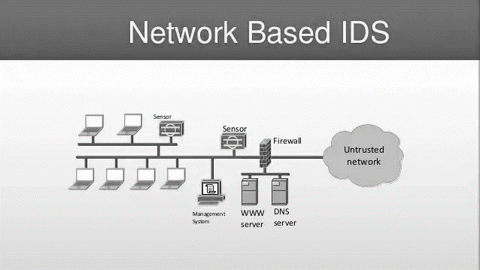
IDS
Network-based IDSs are placed at a strategic point or points within the network to examine passing network traffic for signs of intrusion.
Whereas host-based IDSs are run on individual hosts or devices on the network and look at user and process activity for signs of malicious behaviour.

Slide 13
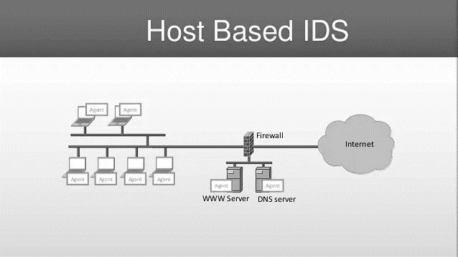
Host-Based
A host-based intrusion detection system (HIDS) is additional software installed on a system such as a workstation or a server.
It provides protection to the individual host and can detect potential attacks and protect critical operating system files. The primary goal of any IDS is to monitor traffic.
The role of a host IDS is passive, only gathering, identifying, logging, and alerting

Slide 14
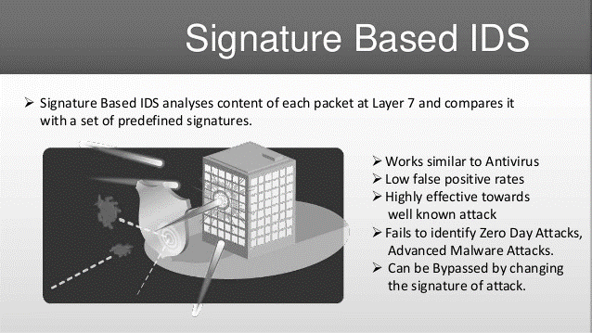
Signature-Based
Signature-based IDSs, which are very effective against known attacks, are deployed.
Signature-based systems (also know as misuse detection systems) detect attacks based on known cases of misuse.
Advantages of misuse detection are high confidence in detection, low false positive rate and an unambiguous detailed identification of attack.
Disadvantages are inability to detect unknown attacks and the need for expert knowledge to create signatures

Slide 15
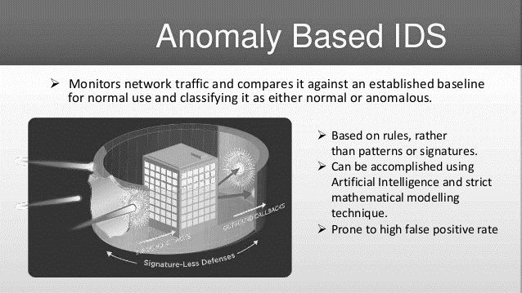
Anomaly Detection
Anomaly detection has attracted the attention of many researchers to overcome the weakness of signature-based IDSs in detecting novel attacks.
Anomaly IDS—that are looking for abnormal behaviour of a monitored user or system. It is
more effective for detection of unknown, new types of attacks.
However, having a relatively high false alarm rate, anomaly detection has not been wildly used in real networks.

Slide 16
IDS
An IDS is the high-tech comparable to an intruder alarm, one that is constructed to
display data entries, unfriendly activities, and known intruders.
An IDS is a dedicated tool that knows how to analyse and interpret network traffic and/or host activities.
This data can range from network packet examination to the contents of log files from routers, firewalls, and servers, local system logs and access calls, network flow data, and more.
Additionally, an IDS often stores a record of known attack signatures and can compare patterns of activity, traffic, or behaviour it sees in the data it’s monitoring against those signatures to distinguish when a close match concerning a signature and existing or a new behaviour occurs

Slide 17
Ping of Death
A well-known pre-set instruction in a misuse IDS for spotting a denial of service attack is called the “Ping of Death,” which is one of the oldest network attack types.
This kind of attack is mainly categorised by sending a very large ICMP echo request packet, intending to incite an unobtainability of network services among connected multiple operating systems by generating bugs or causing programming errors in vulnerable software.
An “ICMP echo request” packet thus is considered as an attack when its size is superior to 65.535 bytes. Notice that this encoded rule simultaneously belongs to misuse-based and network-based IDSs.

Slide 18
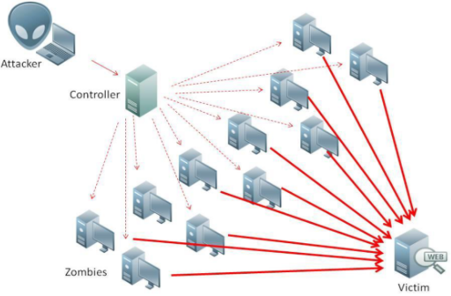
Ping of Death
The ping command is usually used to test the availability of a network resource.
It works by sending small data packets to the network resource.
Since the sent data packages are larger than what the server can handle, the server can freeze, reboot, or crash.

Slide 19
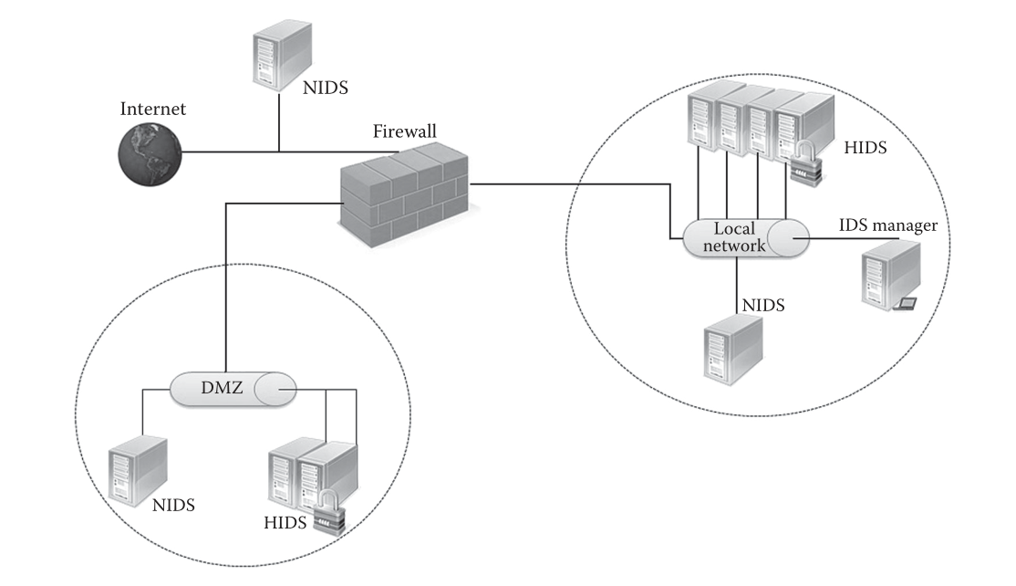
DMZ
DMZ (Demilitarised Zone). Each segment of this connected network, holds a network-based intrusion detection system (NIDS) monitoring the corresponding network segment.
In addition, those servers that are considered critical may have a Host-based Intrusion Detection System (HIDS) implemented and used to monitor some specific events possibly happening on these servers.

Slide 20
Way Of Analysis:
Anomaly IDS—that are looking for abnormal behaviour of a monitored user or system. It is more effective for detection of unknown, new types of attacks.
Misuse IDS—targeted for detection of well-known attacks, thanks to comparison of analysed data with the data that is specific to attack behaviours (so-called signatures).

Slide 21
Reaction To Attack:
Active—that after finding the attack the IDS attempts to block it for instance, by modifying firewall rules in order to block traffic from suspicious IP addresses or disconnecting the network. Active IDS are called Intrusion Prevention Systems (IPSs).
Passive—that transfer only information about the attack to a human administrator

Slide 22

IPS Capabilities
Intrusion Prevention Systems provide various capabilities at both the host level and the network level, but from a high-level perspective, the proficiencies provided by Intrusion Prevention fall into the following two major categories:
Attack prevention
Regulatory compliance

Slide 23
IPS Capabilities
The main capability provided by Network Intrusion Prevention is the ability to prevent malicious traffic from reaching the target system.
Detection systems have been used for years, but each of them always allowed a certain amount of malicious traffic to reach the target systems.
With the introduction of Intrusion Prevention, you have the ability to proactively defend your network against attack.

Slide 24
Attack Prevention
The main capability provided by Network Intrusion Prevention is the ability to prevent malicious traffic from reaching the target system.
Detection systems have been used for years, but each of them always allowed a certain amount of malicious traffic to reach the target systems.
With the introduction of Intrusion Prevention, you can proactively defend your network against attack.
Four widely adopted technologies stand out as having had a tremendous impact on the evolution
of security threats and thus the evolution of IPSs:
Client-server computing
The Internet
Wireless connectivity
Mobile computing

Slide 25
Regulatory Compliance
Regulations force many network operators to guarantee that certain security restrictions are enforced on your network.
These requirements are especially robust with the respect to networks that handle medical information on patients.
Deploying both Network Intrusion Prevention System (NIPS) and Host Intrusion Prevention System (HIPS) can assist in being compliant with many of these requirements.

Slide 26

Slides and Tutorial are accessible via Moodle

